Slide 1
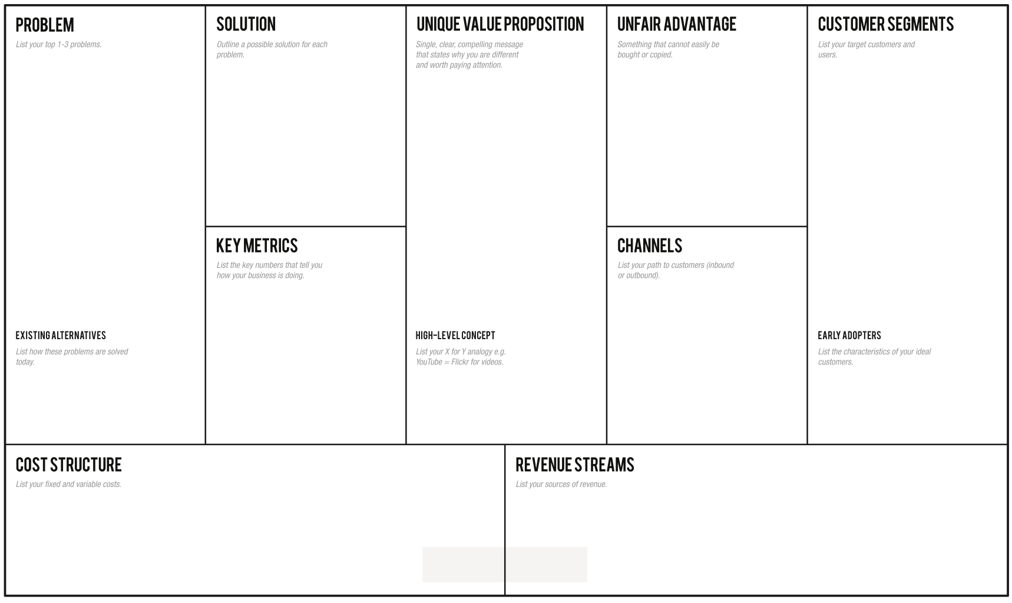
Current dating application users are struggling in building long-term relationships with those matched users.
Most dating application users fail to maintain the long conversation because the application user and matched user does not share some preferences in common. For example, activities, hobbies, or personality.
Many dating application users cannot maintain a relationship with a matched user because most users prefer to have physical interaction before continuing a deeper relationship with their interested individual.
Some dating application users run out of ideas where they should spend time / date together with their interested individual.
Use a dating application which allows users to specify their lifestyles so that other users can immediately recognize individual’s preferences in certain aspects.
Use a dating application that collects user’s preferences to recommend some interesting users based on some characteristics fed to some statistical models.
Use an event application that encourages users to attend interesting events in their nearby area so that they can have some ideas where to bring those interested individuals to hang out / date.
The ability to shorten the time for a dating application’s user to find the right person who shares common activities, music taste, personality, etc. This is achieved by a preferred activities-based recommendation as well as an optional personality-based recommendation.
The application allows end-users to explore some interesting activities and events available in their nearby region / areas. Users can also filter their interested events based on a category-based events filter.
Full-features offered after subscription that allows users to access unlimited likes, know who likes you, boost up the rate which other users can see you, allows other users to see that you like them (Super like), etc.
People who would like to hangout with matched users but have no idea which events / activities they should do to impress them.
People who are single and seek for someone who has common preferences in hobbies, lifestyles to hangout / date with.
People with busy daily routines who do not have enough time to look for someone to have a relationship with.
Number of event’s owners that register their events to the application.
Number of dating application’s users (as a pair of matched users) who participate in events displayed in the application.
Number of accepted invitations to some events / location created by either registered event owners, or end-users themselves.
Number of application downloads per month
Number of end-users who purchase a subscription to access full features offered by an application.
Rating on the application platform such as, App Store, Google Play Store.
Advertisement via Social Media platforms such as, Facebook, Instagram, Twitter, etc.
Advertisement via Search Engine platforms such as, Google, Youtube, etc.
Use the dating application to find someone who is interested in them, and discover those interested individuals’ preferences by initiating conversation.
Some dating applications such as Coffee Meets Bagel, offer some functionality that allows users to specify their incoming partner’s specification, preferences in plain text only.
Use other social network platforms to explore interesting activities in their nearby area. For example, Facebook Events, etc.
Think of the application as the combination of dating applications called “Tinder” and “Coffee Meets Bagel” with a user’s preference-based recommendation together with events recommendation.
People in the age range of 20-40 years old who are single. This is because people with these demographic characteristics do not really have free time to search for people who share some preferences in common.
Fixed Cost
Domain cost
Tax
Variable Cost
Salary
Developer
Designer
Maintenance
Advertisement
Subscription to full-access features offered by the application. This also includes Advertisement avoidance.
Event owner who registers their events to the application. They also need to pay an extra amount of money in case of boosting up the visibility of their event on the application.
Available space for product advertisement. E.g. Advertisements that appear on the matching page.

